Slide 1
Transparency, Safety and Infrastructure Safety Star Ratings
Martin Small
President
Australasian College of Road Safety
August 2020

Slide 2
The ACRS has called on the Transport and Infrastructure Council to immediately commence work on the following national initiatives as part of the upcoming national road safety strategy:
The Commonwealth to publish consistent infrastructure safety star ratings (covering occupants, pedestrians, cyclists and motorcyclists) in easily consumable form on behalf of all governments.
Prepare and begin implementation of a three-year infrastructure safety investment plan, and a ten-year national safety investment budget to achieve 2030 infrastructure safety star rating targets.
Perfectly Maintained
Absolutely Lethal

Slide 3
Why?
Transparency
Engagement with the community
Good quality investment decisions
Good quality policy decisions
Performance management
Elimination of fatal and serious injury on the road
Perfectly Maintained
Absolutely Lethal

Slide 4
Outcome by 2020
“3-star AusRAP ratings or better for 80% of travel on state roads and 90% of travel on national highways”
What is the current status of this performance measure?
What do you find when you google “3-star AusRAP ratings”?
Perfectly Maintained
Absolutely Lethal

Slide 5
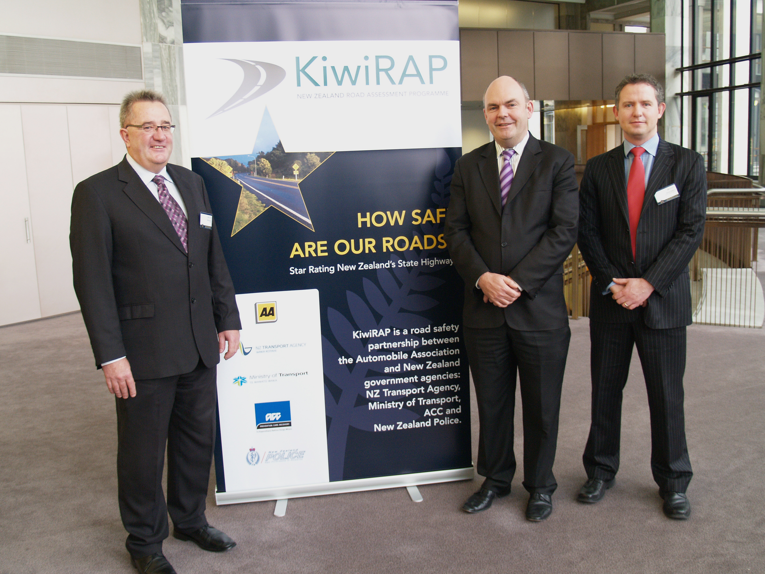
If achieve >75% of travel on 3-star or better roads for all road users by 2030:
Saving of 19,203 per year
Benefit to cost ratio of 3
CASE STUDY: KiwiRAP
Multi agency partnership
25,000km Star Rating assessments
USD$8.5 billion invested in safety
Multiple technical working groups
Innovating with IRR Light Model
Awarded IRF Global Road Achievement Award
Notes:
KiwiRAP is good example of effective technical leadership.
Multiple technical working groups dedicated to specific issues.
Innovating with the development of the IRR (Infrastructure Risk Rating) Light Model which will benefit NZ and through iRAP’s Innovation Framework, the world.

Slide 6
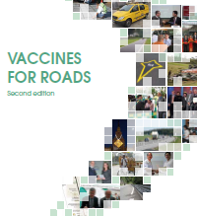
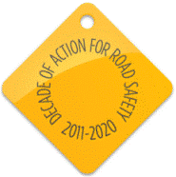
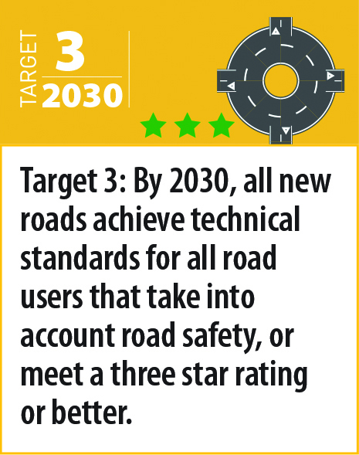
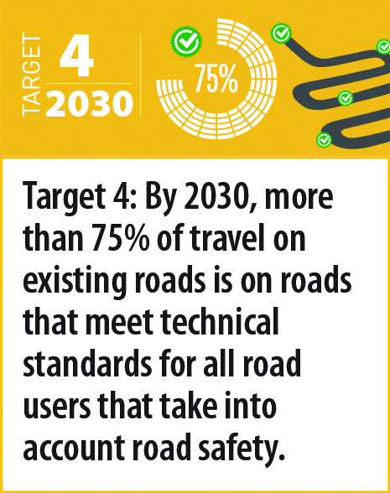
RAP History
RAP techniques for LMIC
Decade of Action Partnership
1999
2006
2011
2005
2008
70
Countries
worldwide
Partnership of British, Dutch and Swedish Governments, European mobility clubs and safety charities
20
Countries
worldwide
China MoT partnership
2012
ThaiRAP launch with Chula, DOH and DRR
2017
IndiaRAP launched at AITD
with FedEx support
2018
2013
South Africa RAP launched
2015
UN Member States agree target for
3-star or better roads
iRAP’s Major Donors
Sustainable Development Goal to halve road deaths and injuries
2019
MyRAP launch - MIROS
BrazilRAP launch - DNIT
100+
Countries
worldwide
Notes:
The Road Assessment Programmes began in 1999 as a partnership between the leading Governments and Mobility Clubs in Sweden, Netherlands, UK and Spain.
Seeing the success of the New Car Assessment Programmes in creating systematic improvements in vehicle safety the programme sought to achieve the same impact with road infrastructure.
As the programme expanded across Europe, the Australian mobility clubs led the development of AusRAP, the AAA Foundation for Traffic Safety established the usRAP Programme and a partnership of Government and Clubs saw the kiwiRAP Programme commence.
By 2005 more than 20 countries had RAP activities and given the scale of the global road trauma identified in the World Health Report, the FIA Foundation helped the establishment of iRAP as the umbrella programme for established programmes and with a focus on helping LMICs. From here Star Rating models, Fatality Estimates and Investment Plans were developed for pedestrians, cyclists, motorcyclists and vehicle occupants that could work in rural and urban areas and provide the business case for safer roads – even in countries with poor existing data.
Together with the World Bank GRSF the new processes were trialled worldwide and the approach refined based on that experience.
iRAP and the Ministry of Transport in China established the beginnings of ChinaRAP in 2008 and in 2010 with the launch of the UN Decade of Action the FIA Foundation provided a long-term donation to the charity to allow the tools to be free-to-air.
By 2012 70 countries worldwide had undertaken RAP projects as summarised in the Vaccines for Roads second edition. South Africa RAP was launched in 2013 and the UN Sustainable Development Goals, including the global goal to halve road deaths and injuries were announced in 2015 recognising the unacceptable level of death and injury on the world’s roads.
With the support of FedEx, IndiaRAP was formally launched at AITD, building on the World Bank and Indian Government led work across India.
ThaiRAP was launched in 2018 at the WHO Global Meeting in Bangkok, and later in 2018 the UN Member States formally agreed Global Road Safety Performance Targets including the targets that all new roads should be built to a 3-star or better standard by 2030.
The programme continues to expand with locally led programmes with BrazilRAP and MyRAP in Malaysia launched in 2019.
More than 100 countries worldwide have benefited from the charitable work of iRAP, and every country is encouraged to build and develop their own national programme in partnership with Government, Research Experts and Mobility Clubs for the mutual benefit of all.

Slide 7
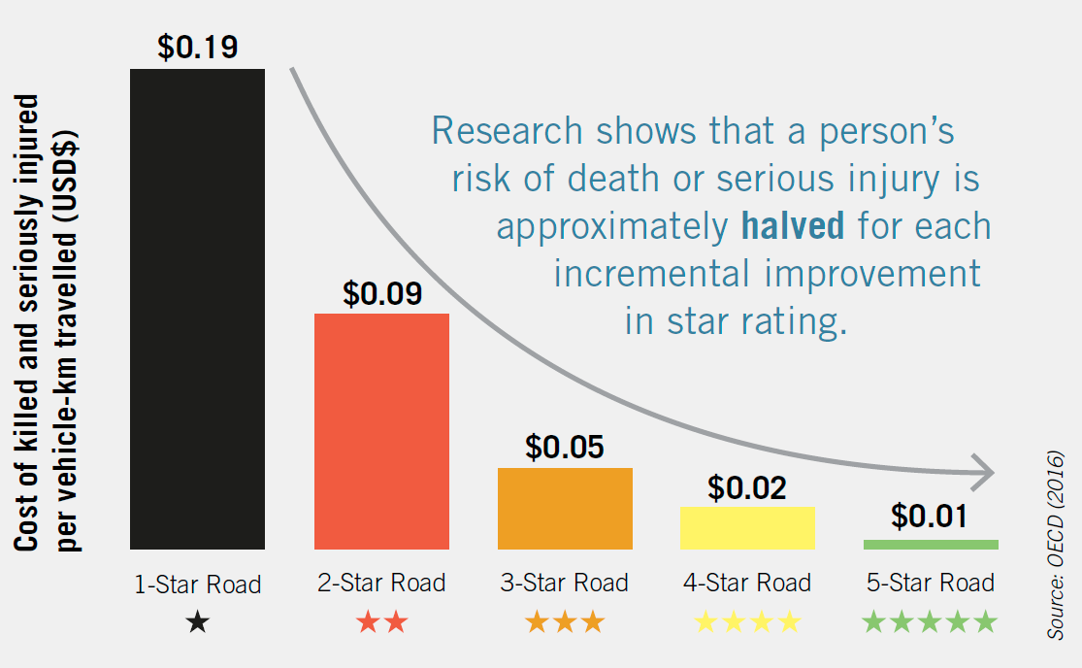
Vision Zero and 5-Star Roads
Notes:
From a range of studies around the world the relationship between infrastructure star ratings and crash costs is clear as reported in the ITF / OECD Safe System Report.
As you can see here the risk of being killed or seriously injured is approximately halved for each improvement in star rating. From 1-star to 2-star the level of death and injury is halved….from 2-star to 3-star the level of death and injury is halved again.
Clearly you do not want yourself – or your family having to walk or cycle on a 1 or 2-star road; or drive on a 1 or 2-star road.
Sadly many of the roads in ASEAN are one or two stars for all road users. But that is our opportunity to make a difference over the next ten years.

Slide 8
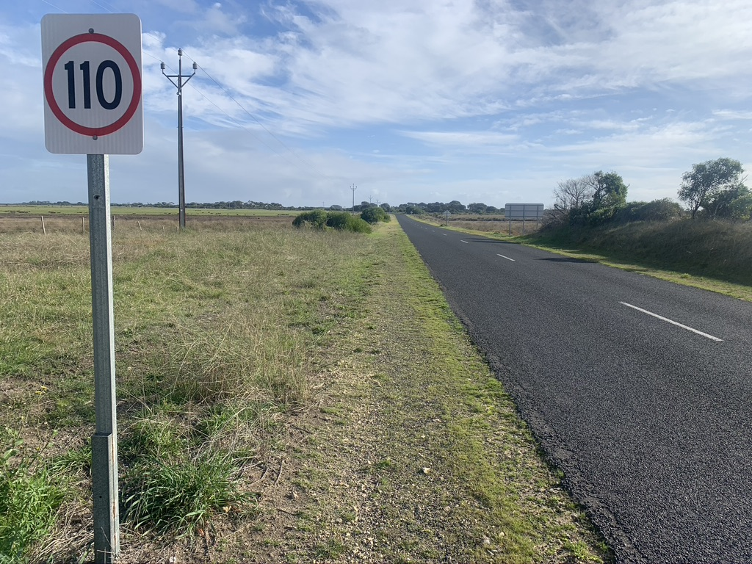
Perfectly Maintained
Absolutely Lethal

Slide 9
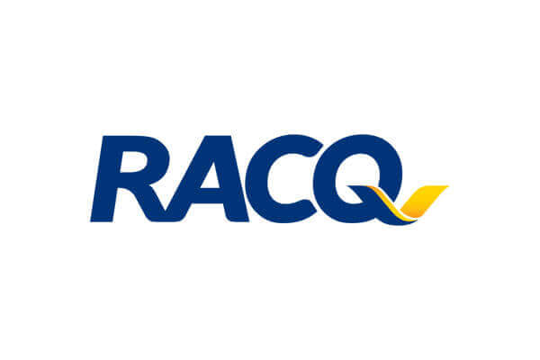
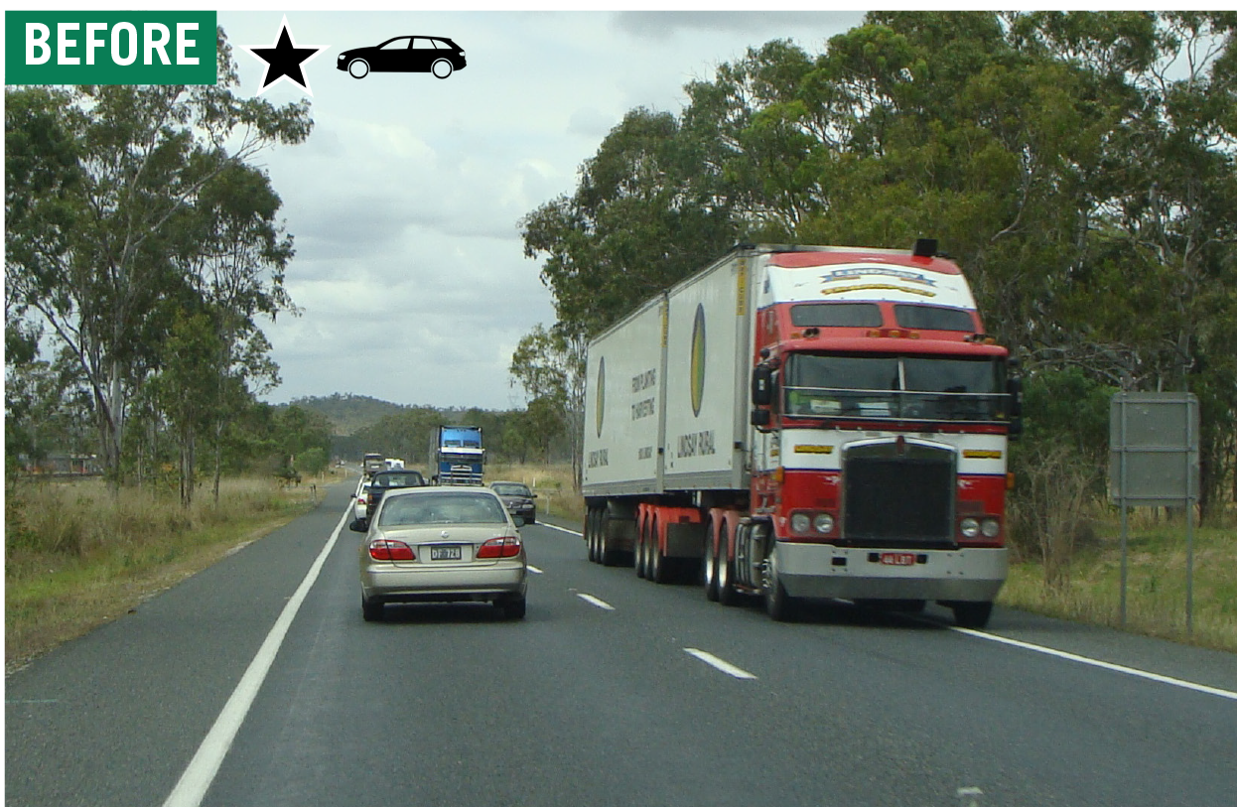
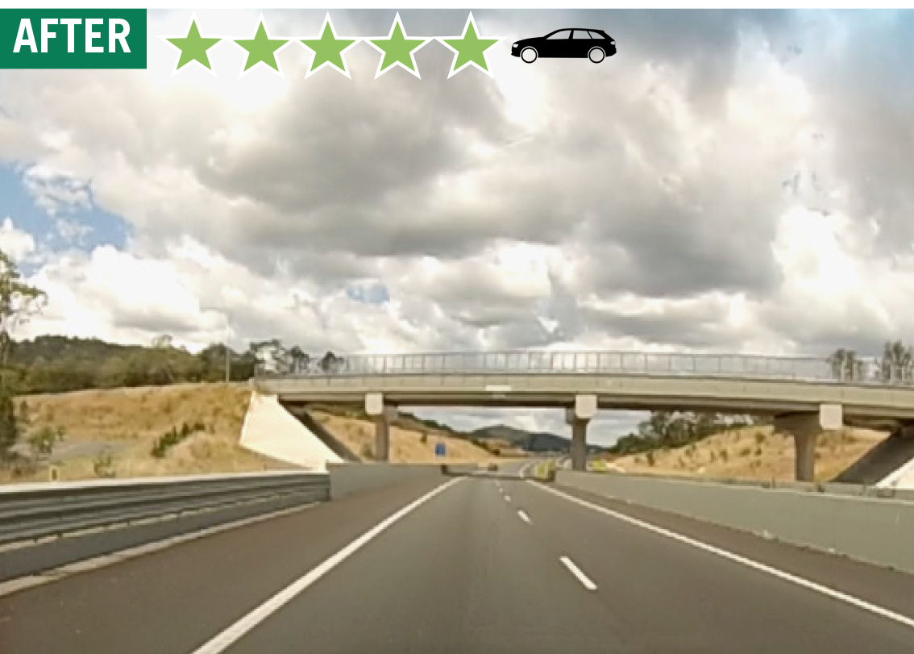
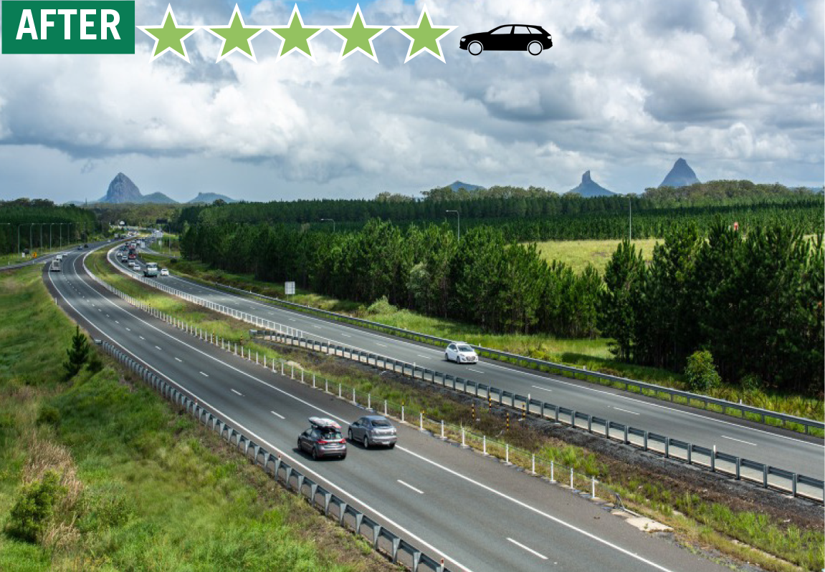
QUEENSLAND, AUSTRALIA
Bruce Highway
82% reduction in fatal and serious injuries and risk of death and injury more than halved
Safety jump from 2-stars to 4 and 5-stars
Reduction in head-on, run-off-road and intersection crashes
Images credit: TMR
Notes:
The Cooroy to Curra stretch of the Bruce Highway in Queensland, Australia used to be one of the country’s most dangerous stretches of highway. Now it is one of the safest following an AUD$1.43+ billion investment in safety.
The four-section Queensland Department of Transport and Main Roads (TMR) project involved a 62km realignment and upgrade of the highway to separate long distance traffic from local traffic movements. It now allows the highway to function safely as a high-speed, high-volume corridor.
The Section A upgrade opened in May 2017 and was assessed by the Australian Road Assessment Program (AusRAP). The star rating for the stretch jumped from 2-stars as a 90km/h undivided road, to a much safer 4 and 5-star 110km/h divided road following the upgrade. A risk mapping assessment before and after confirmed a 75% reduction in casualty crashes per year.
This follows the 2013 completion of Section B - a new four lane divided highway with upgraded interchanges – now ranking 4-5 star in safety. Casualty crashes have dropped by over 80% with head-on and run-off-road crashes reducing dramatically.

Slide 10
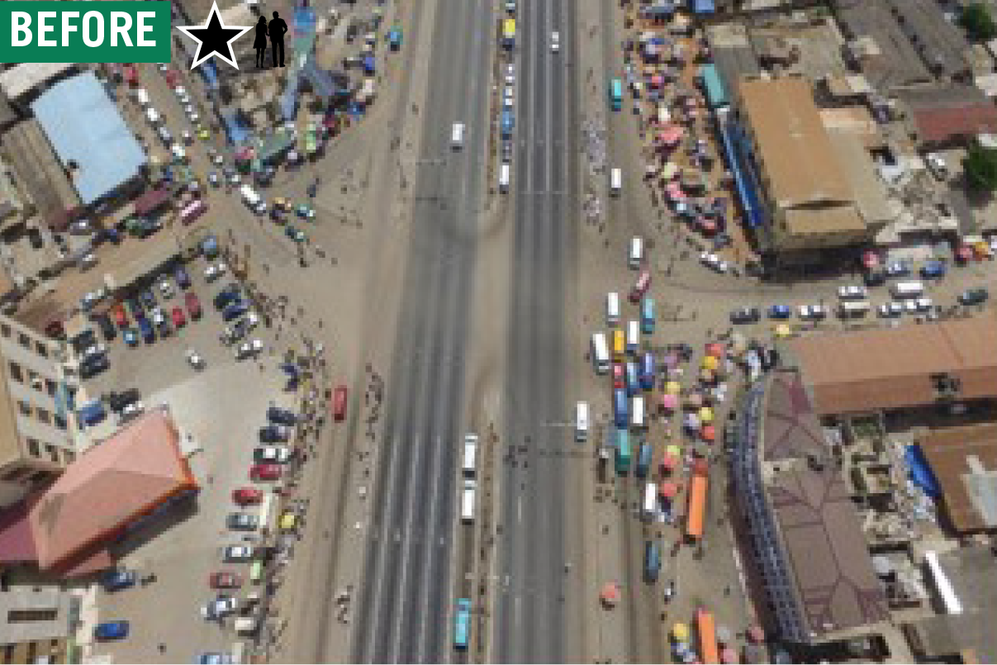
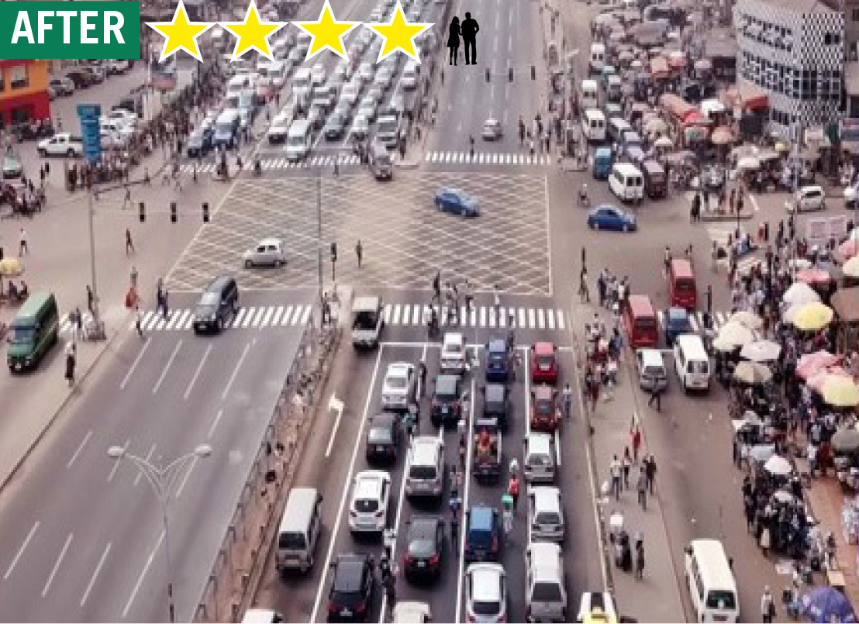
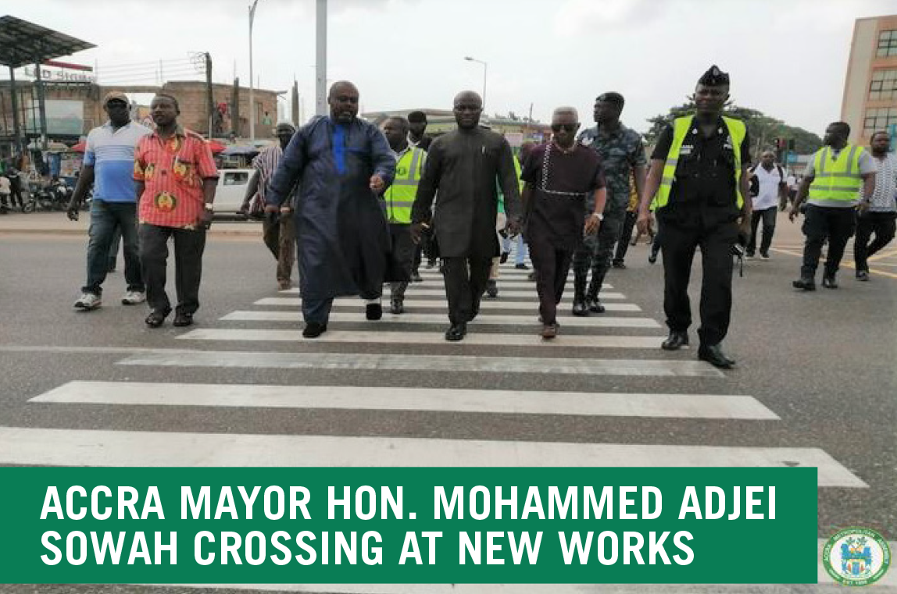
ACCRA, GHANA
Lapaz Intersection, N1 Highway
In 2015, a person died every fortnight at the Lapaz intersection.
Pedestrians and cyclists mixed in 14 lanes of traffic travelling at speeds of 90-120 kms/hr.
An iRAP supported upgrade project vastly improved safety, funded by Accra Metropolitan Assembly (AMA) and the Bloomberg Philanthropies Initiative for Global Road Safety.
Notes:
In 2015, a person died every fortnight at the Lapaz intersection of the N1 Highway in Accra. Every day, pedestrians and cyclists took their lives into their own hands to cross 14 lanes of traffic mixing heavy vehicles and cars travelling at speeds of 90-120 kms/hr.
An iRAP supported upgrade project has vastly improved safety, funded by Accra Metropolitan Assembly (AMA) and the Bloomberg Philanthropies Initiative for Global Road Safety (BIGRS).
The works included increasing signal timing from 18 to 42 seconds to allow pedestrians more time to cross, lowering kerbs to assist the physically challenged, narrowing the lane widths, widening the median refuge, replacing crash barriers and remarking the pavement.

Slide 11
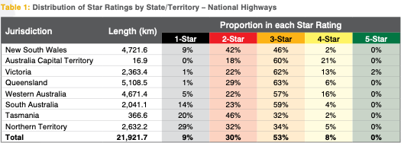
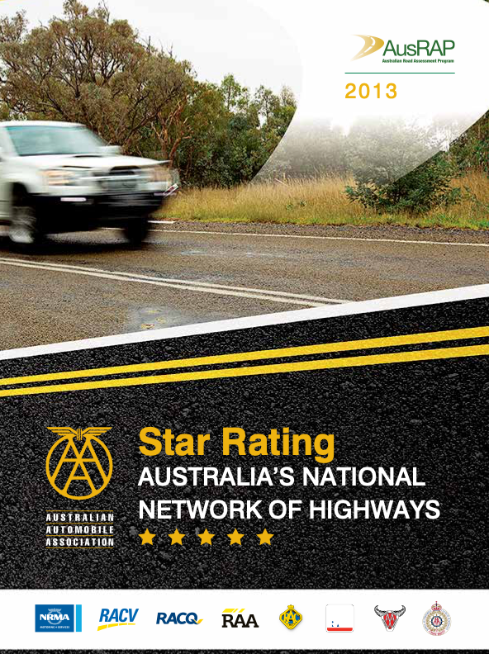
The mobility clubs of Australia and New Zealand have done their part
It is now time that the roads and traffic authorities do theirs

Slide 12
Where are all these 1 and 2 star roads?
What can be done, and what is being done, to eliminate them?
Why is this essential public safety information unavailable to the public?
How can we realise ZERO without this essential public safety information?
www.vaccinesforroads.org

