Slide 1

Dealing with the Standards, Technology and Delivery Deficits surrounding Risky Behaviour
Martin Small
martin@martinsmallconsulting.com
MARTIN SMALL CONSULTING

Slide 2
Back in the day …
“How fast does someone have to go to get a ticket around here?”
“I don’t chase drink drivers, I prevent drink driving!”
High volume high profile general deterrent policing
Communications that increase the perceived risk of detection
MARTIN SMALL CONSULTING

Slide 3
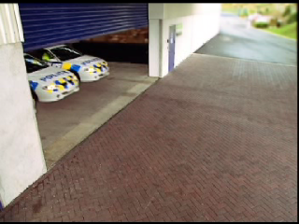

Slide 4
Speeding Infringements Issued
800,000
600,000
Total
400,000
Camera
200,000
Other
0
Vehicles exceeding 110 km/h
30%
25%
20%
15%
10%
How will we re-invigorate our existing behavioural programs, which remain essential?
MARTIN SMALL CONSULTING

Slide 5
20 Years Later
12 road safety performance targets were prepared collaboratively under UN auspices
Six deal with risky behaviour
MARTIN SMALL CONSULTING

Slide 6
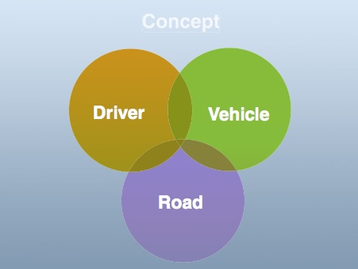
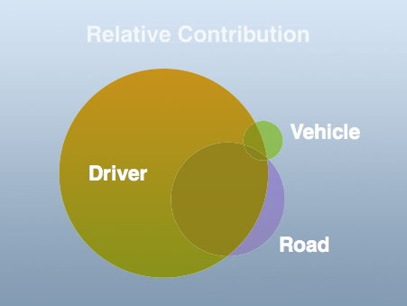
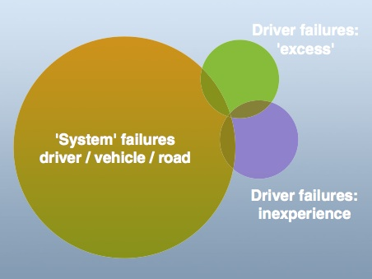
We must focus on system failures, not human failures
Classifying apparent crash cause into failures of the driver, road and vehicle leads to driver error as the problem, present in 95%, and dominant 2/3^{rds} of crashes
Classifying crashes into failures of the driver, road and vehicle system (“system” failures), leads to a small number of crashes resulting from driver failures of excess or inexperience
Rod Kimber, TRL, 2003

Slide 7
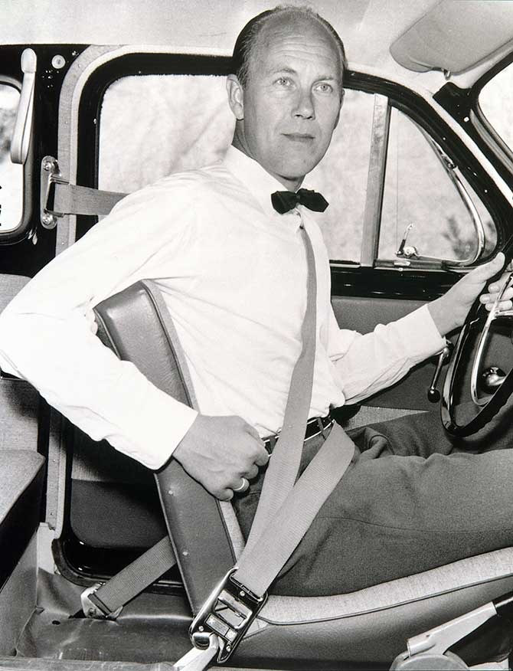
We need strong on-road enforcement until we address the technology deficit
Ever since the seatbelt, the two critical vehicle safety tasks for governments have been to:
  Promote the introduction of critical new safety technology into national fleets
  Mandate new vehicle safety technology through setting national design and construction standards
  This needs applying to the sustained behavioural issues over the course of this decade – seatbelts, speed, alcohol, mobile phones, fatigue
MARTIN SMALL CONSULTING

Slide 8
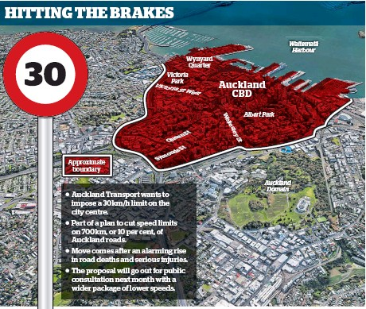
We need to come clean on risky behaviour
ACRS policy is for a national RIS that redefines the basis of what a risky travel speed is on both urban and rural roads
Alcohol levels also need redefining
MARTIN SMALL CONSULTING

Slide 9


We need to address the delivery deficit
Recommendations 1 & 2 address:
Sustainable Practices and Reporting
Procurement
The Social Model approach could assist:
SafeWork Australia publish guidance on road traffic injury, the no.1 fatal injury in the workplace
Austroads require safety through ISO 39001, just like they require quality and environment through ISO 9001 and 14001
MARTIN SMALL CONSULTING

